Slide 1


Social Buzz Content Analysis
Notes:
30.09.2022
1

Slide 2


Today's agenda
Project recap
Problem
The Analytics team
Process
Insights
Summary
Notes:
30.09.2022
2

Slide 3

Social Buzz is a fast-growing, content-focused social media platform with anonymous users, advanced reaction tracking, and over 500 million monthly users.
Project Recap
An audit of their big data practice
Recommendations for a successful IPO
An analysis of their content categories that highlights the top 5 categories with the largest aggregate popularity
Notes:
30.09.2022
3

Slide 4

Problem
Over 100000 posts per day
36,500,000 pieces of content per year
But how to capitalize it when theres so much?
Analysis to find Social Buzz’s top 5 most popular categories of content
Notes:
30.09.2022
4

Slide 5



Meet
The
Team
Andrew Fleming,Chief Technical Architect
Marcus Rompton, Senior Principle
Riya Shivolkar, Data Analyst
Notes:
30.09.2022
5

Slide 6
Process
1
Collected reaction data
2
Cleaned and preprocessed the data
3
Merged datasets to create a unified view
4
Aggregated popularity scores for each category
5
Identified top-performing categories
Notes:
30.09.2022
6

Slide 7
Top Categories
Category | Score
Animals | 71242
Healthy Eating | 69067
Technology | 68521
Science | 66549
Food | 64952
Notes:
30.09.2022
7

Slide 8

Insights & Findings
Total Unique Categories: 29
Most Popular Category: Animals, with a staggering 74,965 reactions. This category has consistently captured the attention and engagement of our audience, making it the clear favorite.
Month with the Most Posts: May 2021. This month saw a surge in activity, with numerous posts across various categories, contributing to a vibrant and engaging community.

Slide 9
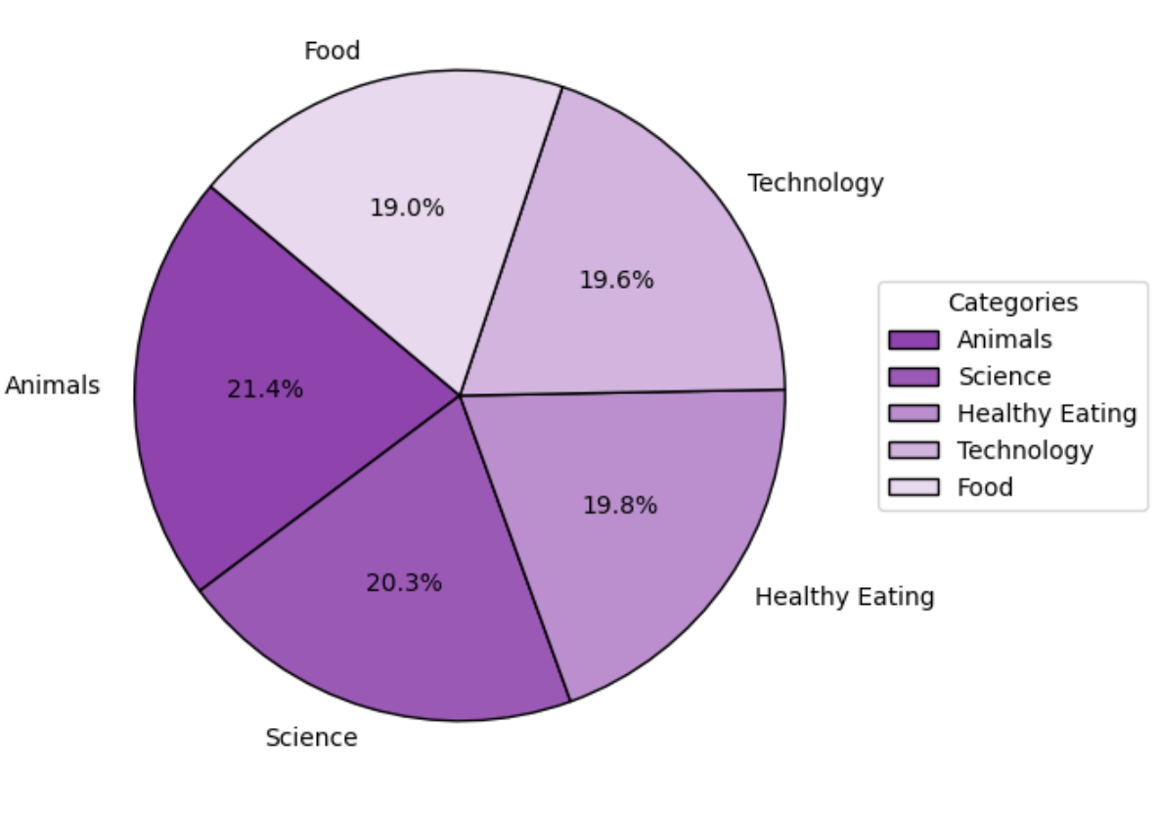
📊 Pie chart of the Top 5 Content Categories

Slide 10



"Animals" is the most popular content category with 74,965 reactions, indicating strong user engagement in animal-related posts.
Summary
Science, Healthy Eating, and Technology also rank high, suggesting a strong audience interest in educational and lifestyle content.
May 2021 had the most posts, meaning content volume and engagement peaked during this period—potentially a seasonal trend or marketing effect.
Notes:
30.09.2022
10

Slide 11
Thank you!
Notes:
30.09.2022
11

